Slide 1
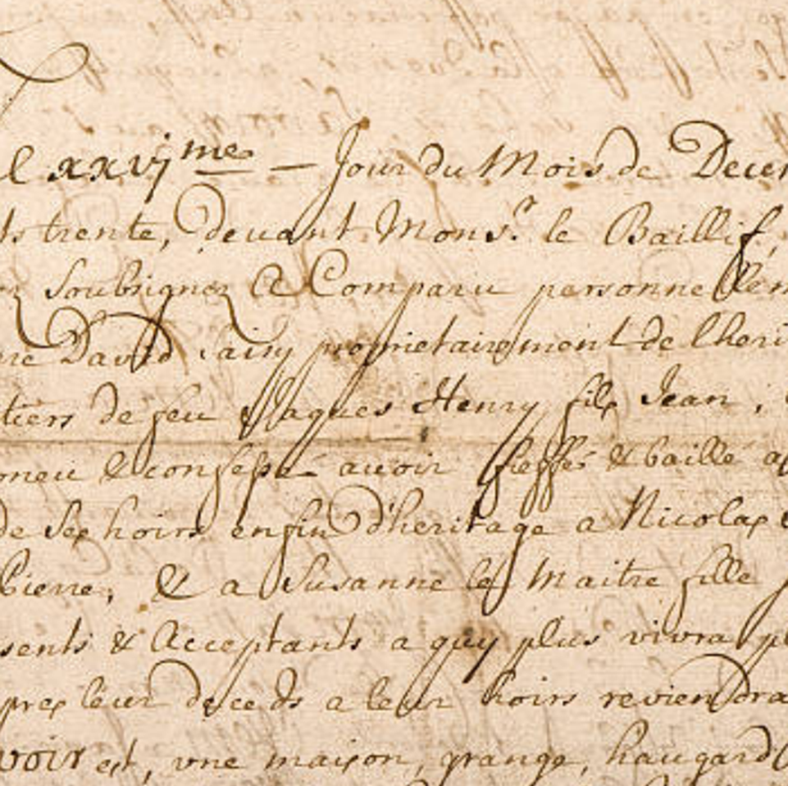
Handwriting Recognition for Historical Documents
MACHINE LEARNING (DSC 805)
A Capstone Project Proposal for Group 4
On 6th March,2026
At
AMERICAN UNIVERSITY OF NIGERIA,YOLA
Graduate school, MSc Data Science & Analytics
By
Anas Yunusa Adamu (A00026424
Sadiq
Moses
Gezawa

Slide 2
Introduction
Digitizing historical handwritten documents manually, is an intensely labour-intensive task, which required a typist with a typewriter or computer with word processors Application.
Computer Vision provides a scalable solution to this challenge, making it more easier to digitize and preserve historical handwritten documents.

Slide 3
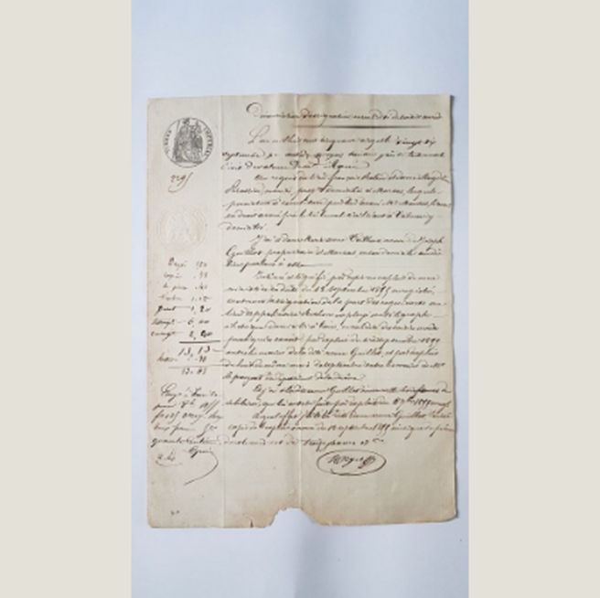
The Problem Statement
The Traditional Method of digitizing historical handwritten documents involve numerous challenges including :
1. Struggling to transcribe vast collections of historical handwritten documents.
2. Unpredictable ink bleed.
3. Traditional Optical Character Recognition (OCR) models fail on cursive historical writing because they are strictly trained on isolated modern characters.

Slide 4






Aim, Objectives & Scope
Aim
Scope
Objectives
Develop a robust, machine learning-based OCR system capable of recognizing and transcribing full lines of historical handwritten text.
Focused entirely on Computer Vision and Cultural Heritage. Strictly based on line-level transcription using the Washington Database.
Build a CRNN to process sequence data, implement CTC Loss to map visual features without bounding boxes, and evaluate transcription accuracy.

Slide 5
Dataset Overview
The Washington Database

Slide 6


Dataset Selection
Limitations of MNIST / EMNIST
Advantages of Washington DB
While simpler datasets provide a solid baseline for isolated digits or uppercase letters, they completely fail to reflect the reality of connected, historical handwriting. Training models on these datasets will not capture the continuous flow, ligatures, and varying spacing of real cursive scripts.
This dataset perfectly encapsulates the core domain constraint. By leveraging the pre-binarized text lines, reduce tedious image cleaning and focus our analytical resources entirely on designing the complex CRNN architecture required for authentic, line-level sequence recognition.

Slide 7
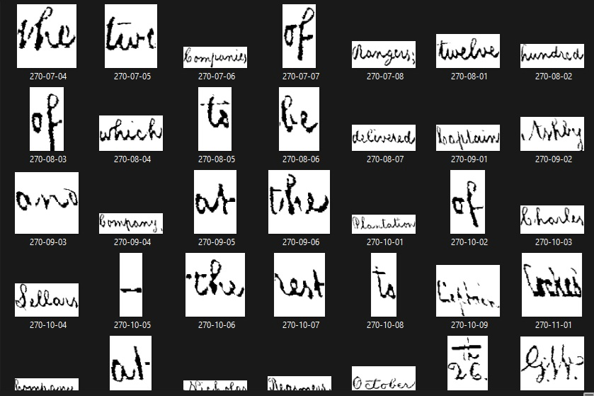
Data Description
18th-Century Longhand Script
Sourced from the George Washington Papers at the Library of Congress, this dataset encapsulates authentic 18th-century English handwriting.
It contains 20 pages comprising 656 text lines and 4,894 word instances, written in ink on paper by two distinct writers.
A major strategic advantage of this dataset is its pre-processed format. The images have already been binarized and normalized into line-level structures, accompanied by precise ground truth text transcriptions.
Dataset Snapshot

Slide 8
Methodology
1. Data Preprocessing: Image binarization, resizing with padding, tensor normalization, and parsing ground-truth transcriptions.
2. Exploratory Data Analysis (EDA): Examine character frequency, text length distributions, and image aspect ratios to guide architecture parameters.
3. Data Augmentation : Apply visual transformations (random shear, rotation, elastic distortion) to simulate historical wear and prevent overfitting.
4. Model Training – Split dataset into 80% Training, 10% Validation, 10% Testing. Implementation of a Convolutional Recurrent Neural Network (CRNN) with CTC Loss.
5. Evaluation & Optimization – Assess models using standard OCR metrics: Character Error Rate (CER) and Word Error Rate (WER) to identify the most effective transcription model.

Slide 9
Model Implementation Stages
2. CNN Extractor
4. CTC Alignment
Pass text lines through a CNN to extract features and output a sequence of visual feature vectors.
Utilize Connectionist Temporal Classification Loss to map visual features to text without precise segmentation.
1. Data Loading
3. RNN Sequence
Write custom parsing scripts to dynamically link FKI ground-truth transcription files to binarized line images.
Feed visual features into a Bidirectional LSTM to capture the contextual flow and letter dependencies.

Slide 10
Required Tools
Programming Language : Python
Libraries/Packages : Python, PyTorch or TensorFlow/Keras, OpenCV (for residual processing), NumPy, and Pandas.
Dataset: Data sourced securely from Research Group on Computer Vision and Artificial Intelligence (FKI)..
Version Control: Collaboration and version tracking via GitHub.
IDE: Visual studio code, Google colab with cloud GPUResources, Jupiter notebook for coding and testing
Hardware Minimum Requirements : Computer with; 8GB RAM, 250/500 GB SSD/HDD, Corei5 CPU/GPU 2.0 GHZ

Slide 11
Deliverables
Model Output: A fully functioning Python-based CRNN predictive model optimized for historical handwriting recognition, alongside a custom data loader pipeline.
Visual performance dashboard: Chart showing the dataset analysis and model performance
Final Project documentation and presentation.

Slide 12
Thank you

Slide 13
References

Slide 14


Image Sources
https://i.etsystatic.com/12085891/r/il/aeef69/3597520345/il_570xN.3597520345_kbu3.jpg
Source: www.etsy.com
https://media.istockphoto.com/id/505693274/photo/old-letter-with-handwritten-text-grunge-vintage-texture.jpg?s=612x612&w=0&k=20&c=pyYYud2B7-cUY3Sjp90PT8WVQaJAUZhHH2tPInq0sWc=
Source: www.istockphoto.com

